Slide 1
HR Assistance for Employee Onboarding and Exit Interviews

Slide 2
Problem Statement
What problem your innovation is trying to solve?
In many organizations, the employee onboarding and exit interview processes are still handled manually, leading to inefficiency, delays, and data inconsistencies.
HR personnel spend significant time managing paperwork, tracking tasks, and conducting repetitive interviews, which reduces productivity and increases the chance of errors.
Moreover, analyzing exit feedback manually makes it difficult to identify trends or reasons behind employee turnover.
The HR Assistance System aims to automate these processes using AI, making onboarding smoother for new employees and providing meaningful insights from exit interviews to help organizations improve retention and HR efficiency.

Slide 3
Product/ Solution - Innovation
Our innovation, HR Assistance System, is an AI-powered platform designed to automate the onboarding and exit interview processes in organizations. It minimizes manual HR work by handling document verification, task tracking, and scheduling automatically. During exit interviews, it uses AI-driven sentiment analysis to understand employee feedback and generate meaningful insights. This system solves major issues like time delays, data inconsistency, and lack of actionable feedback that HR teams often face.
Type of Innovation
This innovation is an incremental improvement over existing HR management tools. While some HR software manages records and workflows, our system adds intelligent automation and AI analytics, making it more adaptive, insightful, and efficient compared to traditional methods.
Uniqueness of Innovation
What makes our innovation unique is its AI integration for both onboarding and exit processes within a single platform. Unlike other systems that focus only on one area, our solution provides a complete employee lifecycle experience, from joining to exit, with real-time insights, automated feedback summarization, and a user-friendly dashboard. It is also cost-effective and customizable for small and mid-sized organizations.

Slide 4
Product/ Solution - Readiness Level
1.Stage:
Our product is currently in the Ideation and Wireframe Design stage, where the concept and structure of the HR Assistance system are being validated through customer research and prototype design.
2.Ideal Customer Profile:
Medium and large-scale organizations with frequent employee hiring and exits
HR departments seeking to automate routine onboarding and exit processes
Companies aiming to improve employee satisfaction and reduce manual HR workload
3.Customer Interview Insights:
Interviews with HR professionals revealed that:
Onboarding consumes a lot of time due to repetitive tasks.
Tracking employee feedback manually is inefficient.
There’s a need for a single platform combining onboarding and exit analytics.
HRs prefer systems that are easy to use, secure, and AI-assisted for insights.

Slide 5
4.Proof of Concept (PoC):
A prototype of the HR Assistance system is being designed using web-based UI mockups showing onboarding workflows, document uploads, and exit feedback forms integrated with AI sentiment analysis.
5.Product Requirement Specifications:
User-friendly dashboard for HR managers
Secure employee data storage and document management
Automated onboarding task tracker
AI-based sentiment analysis for exit feedback
Report generation and visualization module

Slide 6
Team Size, Background, Strength /Capability and Resources
Team Members
1. PRODUCTION LEAD-AISHWARYA M N
2.FRONT END DEVELOPER-AISHWARYA M N
3.BACK END DEVELOPER-KEERTHANA S
4.TESTING& SECURITY HANDLING-KEERTHANA R
5.UI/UX DESGNING –KEERTHANA NP
6.DATABASE ADMINISTRATOR-B SUSHANTH
7.CONTENT AND CUSTOMER Q/A- CHANDHANA SHETTY

Slide 7
Market Landscape - Market Potential, Competitors
1.Market Potential (Based on Ideal Customer Profile)
Target Audience:
  Medium and large organizations (100–1000+ employees).
  HR departments in IT, education, and corporate sectors.
  Universities and startups with high employee turnover.
With the increase in remote and hybrid work, the demand for digital onboarding and exit systems has increased.
Potential customer base in India: Over 50,000+ companies actively using or seeking HR automation tools.
2.Competitors
Existing Tools:
  BambooHR – focuses on employee data and onboarding.
  Zoho People – provides general HR management solutions.
  Freshteam (by Freshworks) – manages hiring and employee lifecycle.
  SAP SuccessFactors – enterprise-level HR software.
However, these are often expensive and complex, limiting access for small to mid-sized organizations.

Slide 8
Total Budget, Required Support and Regulation
Type of Support Required for Final Product Launch
Technical Support:
  Cloud deployment, server maintenance, bug fixing.
Financial Support:
  Funding for marketing and scaling the platform.
Mentorship / Incubation:
  Guidance from startup mentors or HR tech experts.
Institutional Support:
  Reva University incubation cell for hosting pilot programs.
Industry Collaboration:
  Partner with HR consultancies or corporate HR departments for early adoption.

Slide 9
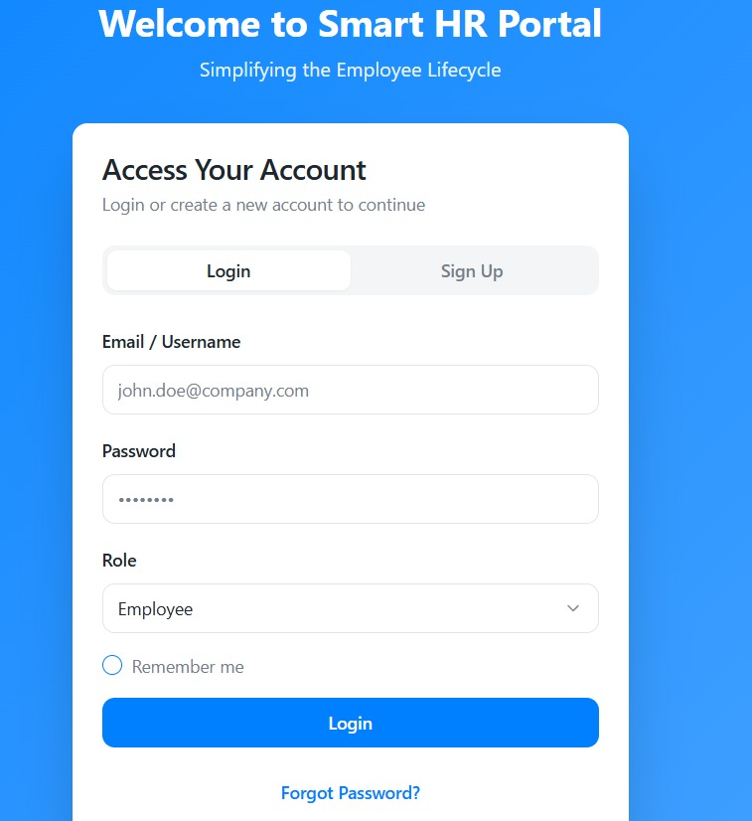
How the front-end works:
This is the login page for Smart HR Portal, designed to simplify employee lifecycle management.
Key Elements:
1. Title: "Welcome to Smart HR Portal" with the tagline "Simplifying the Employee Lifecycle".
2. Login Section:
-Email/Username: Input field (example: raghav123@company.com).
- Password: Masked input field.
- Role: Dropdown set to "Employee".
- Remember me: Checkbox option.
3. Actions:
- Login: Blue button to submit credentials.
- Sign Up: Option for new account creation.
- Forgot Password?: Link for password recovery.

Slide 10
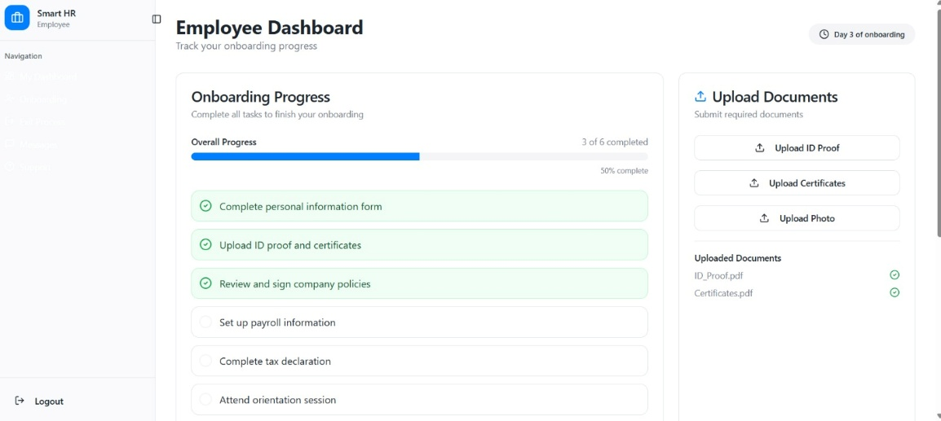
How front end works:
The image shows an Employee Dashboard for onboarding, tracking progress
Completed Tasks:
1. Complete personal information form
2. Upload ID proof and certificates
3. Review and sign company policies
Pending Tasks:
1. Set up payroll information
2. Complete tax declaration
3. Attend orientation session
Uploaded Documents:
1.ID_Proof.pdf
2.Certificates.pdf
The dashboard indicates it's Day 3 of onboarding.

